Slide 1

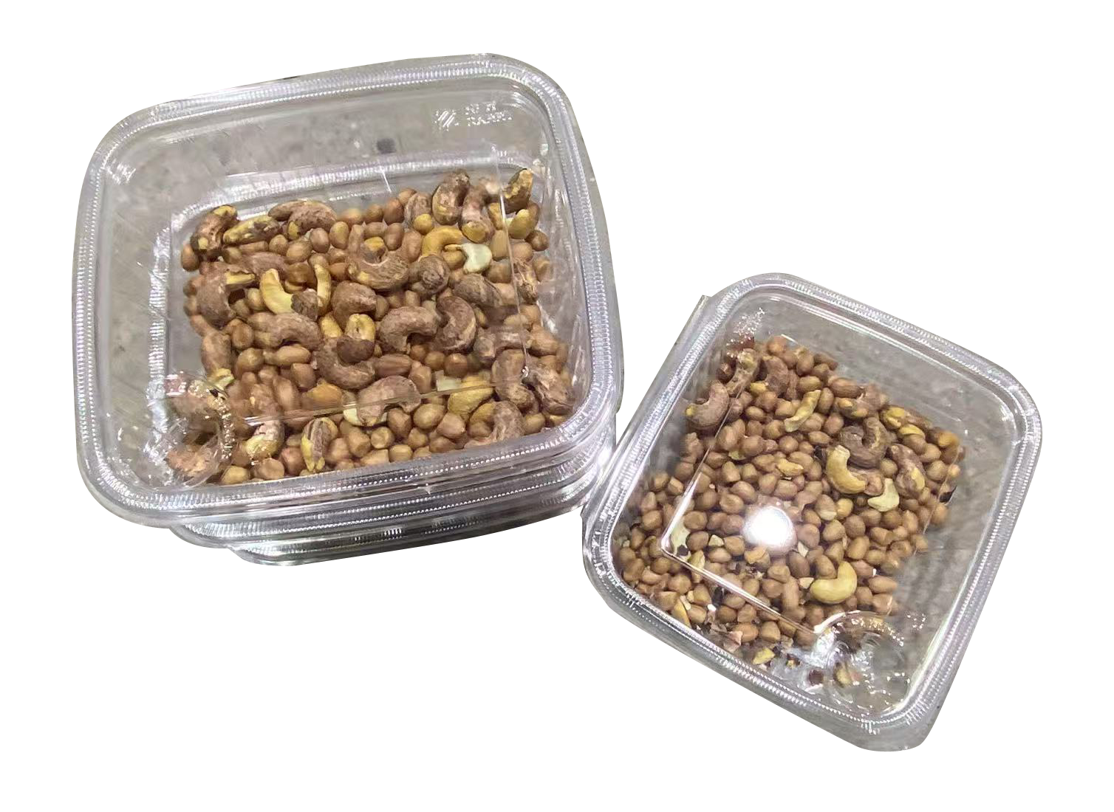
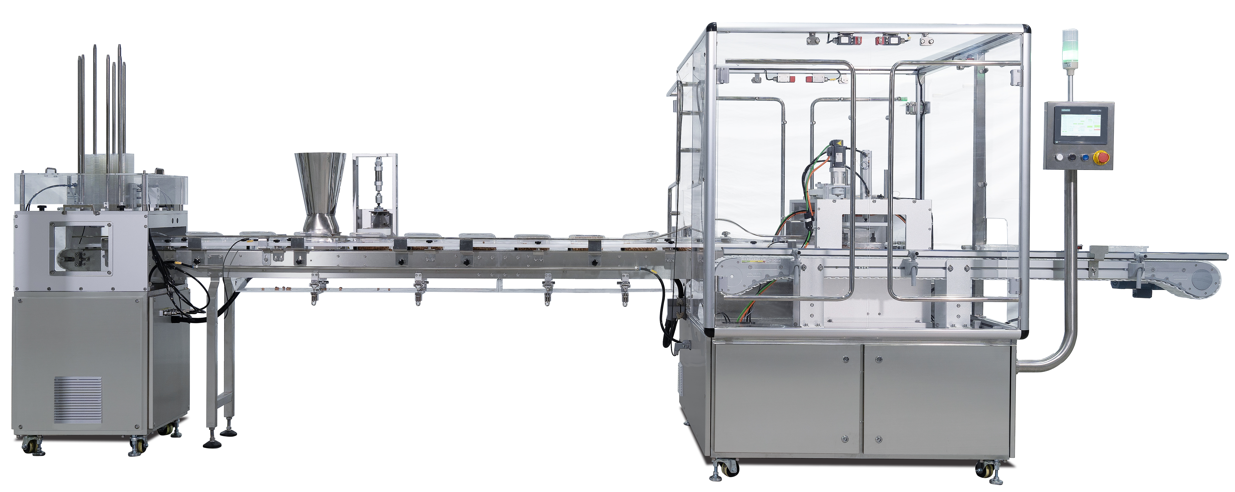
​Clamshell
Fill&Close Machine

Slide 2
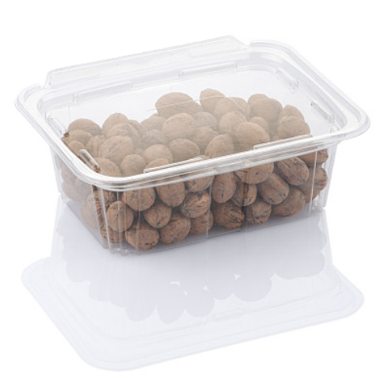
Introduction
CFP-1 is a fully automatic clamsheel fill close machine designed for nut clamshell packaging. It uses servo drive + pneumatic control for precise filling, flip-top closing, and secure sealing.
With a stable output of 20-25 cups/min, it features tool-free changeover for quick size adjustment, easily adapting to different clamshell sizes.
Key Competitive: Stable, Easy Clean & User-Friendly!
✔ Stable & Reliable: Servo & pneumatic control for precise positioning, simple structure, easy maintenance
✔ Flexible Adaptation: Tool-free quick changeover for multi-product production
✔ Clean Filling: Enclosed filling + flattening design minimizes spillage
✔ Easy Cleaning: Quick-release tray, cleaned easily with air blow

Slide 3
Parameters:
Model： | CFP-1
Type: | Single-lane
Capacity: | 20-25 fills/min
Container: | Clamshell
Filling Weight: | 200-1000g
Voltage: | 220V, 60Hz, 1-phase
Power: | 1.5kW
Air Consumption: | 250L/min
Pressure: | 0.6MPa
Dimensions (L×W×H): | 4200×1350×1800mm
Weight: | 500kg

Slide 4
Configuration
Component |  | Configuration
Control System | PLC | Siemens/Germany
 | HMI Touch Panel | Siemens/Germany
Main Drive | Servo Motor & Drive | Siemens/Germany
Pneumatics | Cylinders & Solenoid Valves | FESTO/Germany
Vacuum | Vacuum Generator | FESTO/Germany
Electrical | Sensors | Pilz/Germany
 | Low-voltage Components | Schneider/France
Mechanical | Bearings | SKF/Germany

Slide 5
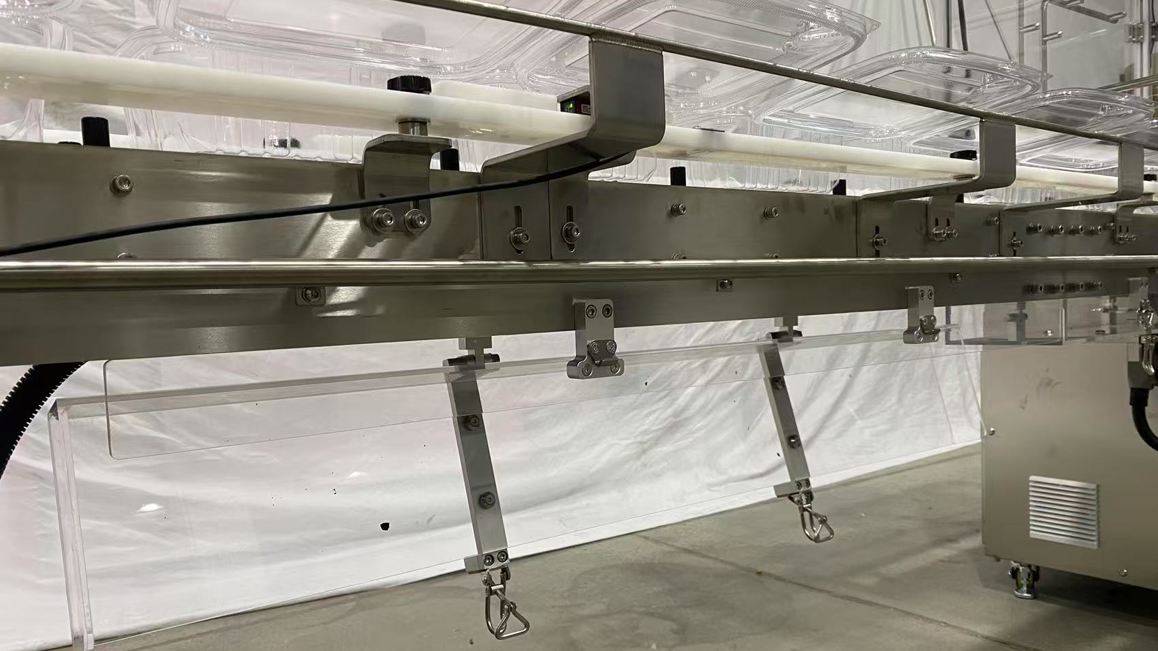
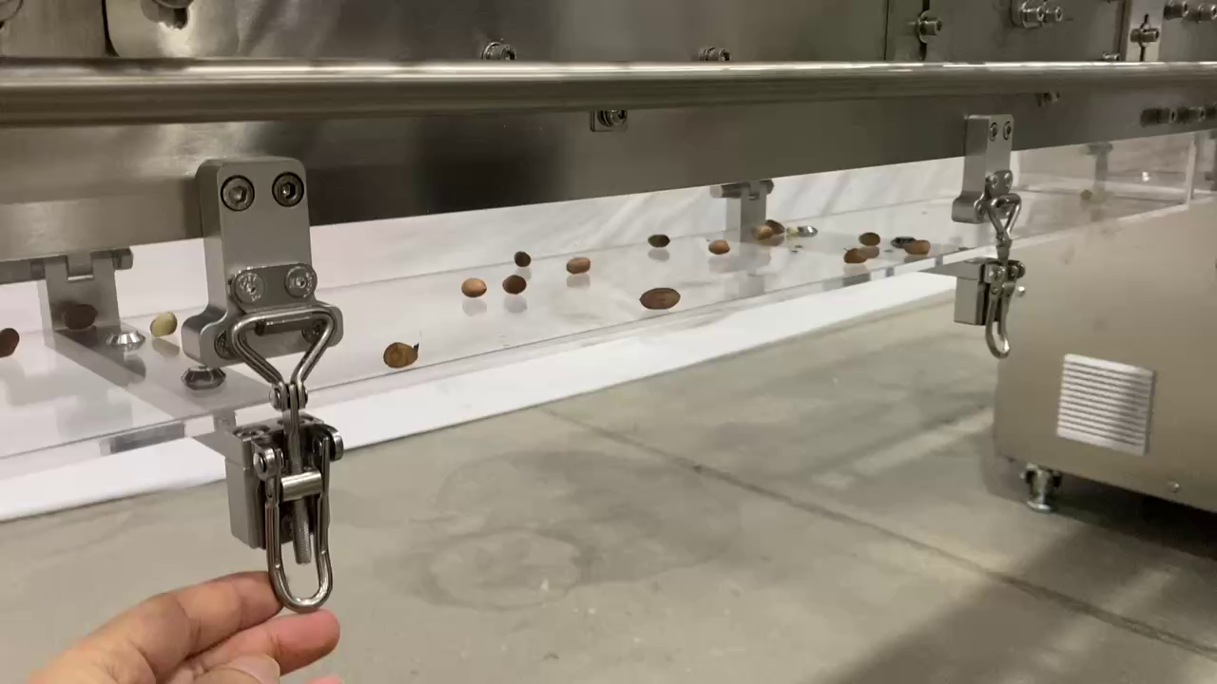
Easy Clean Design
✔Open-frame Drive Design
✔Quick-release snap-on collection tray
✔Enables fast dismantling & effortless cleaning (air-blow compatible)

Slide 6
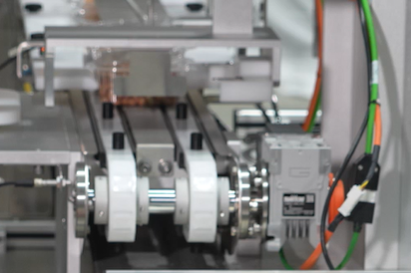
Precision Positioning
✔Precision positioning guaranteed by servo control
✔Flexible conveying design, handles different sizes without manual adjustment

Slide 7
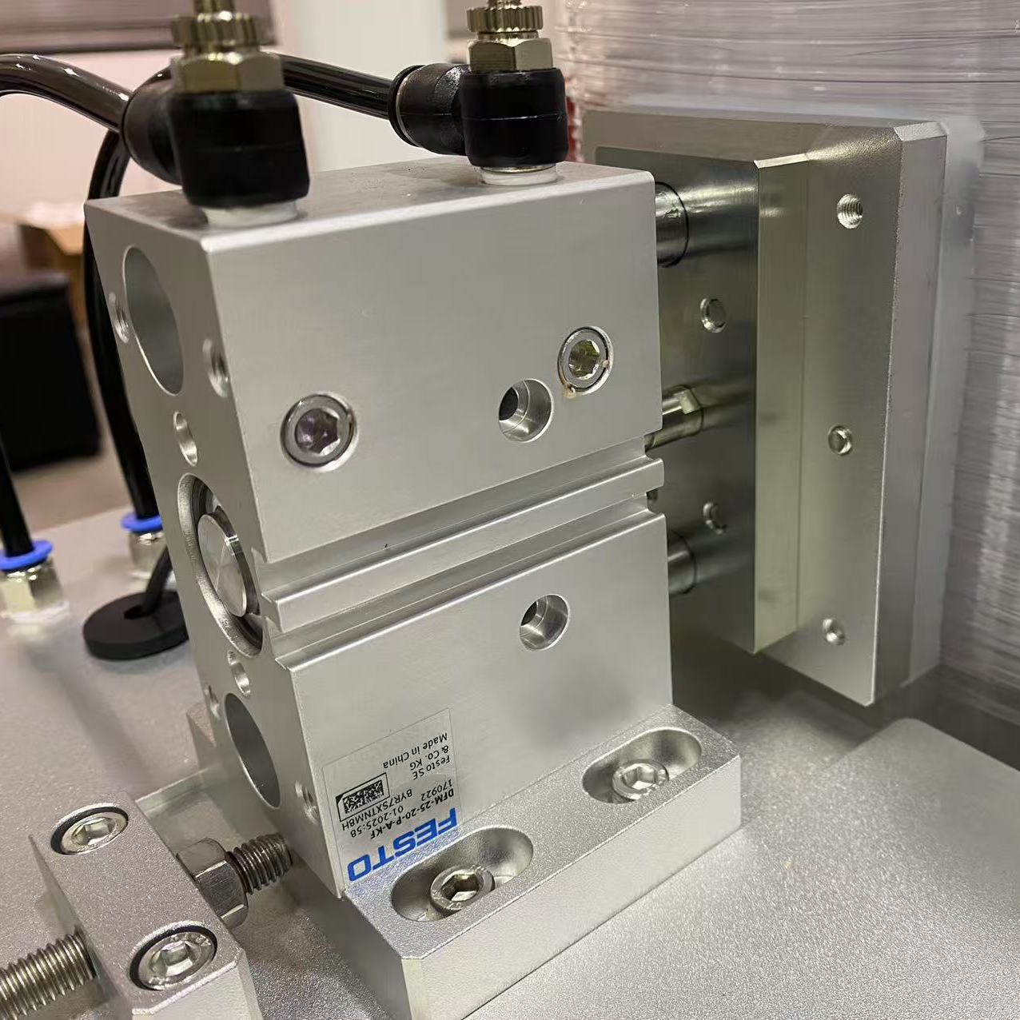
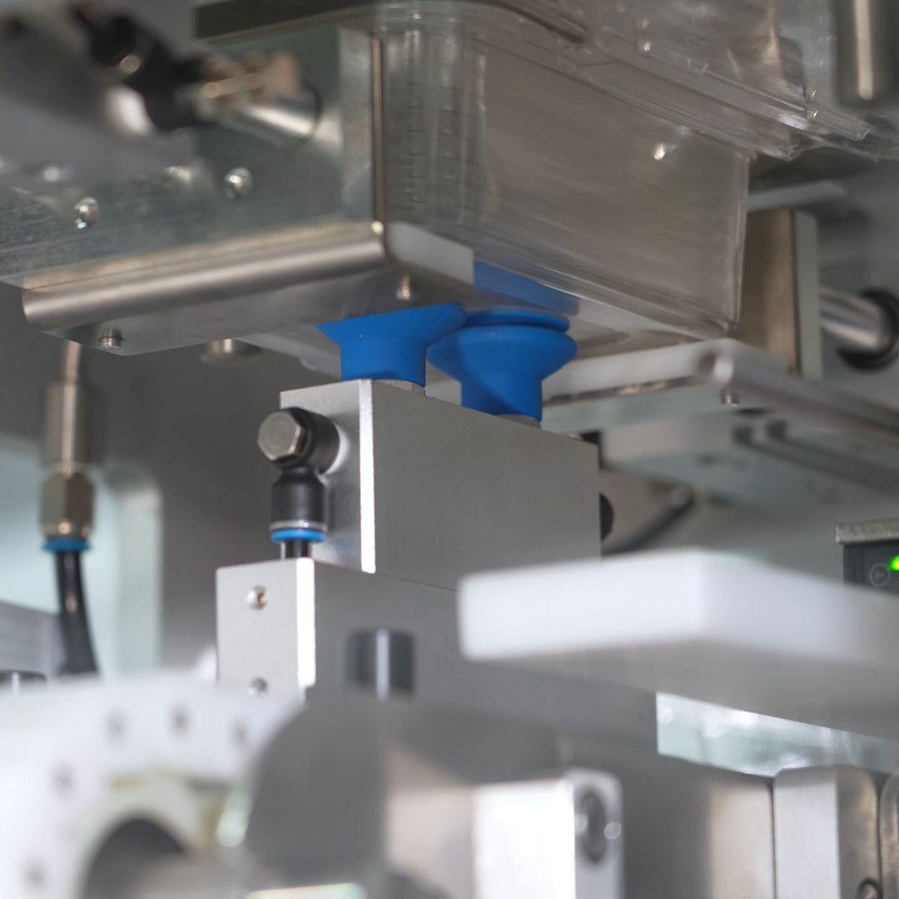
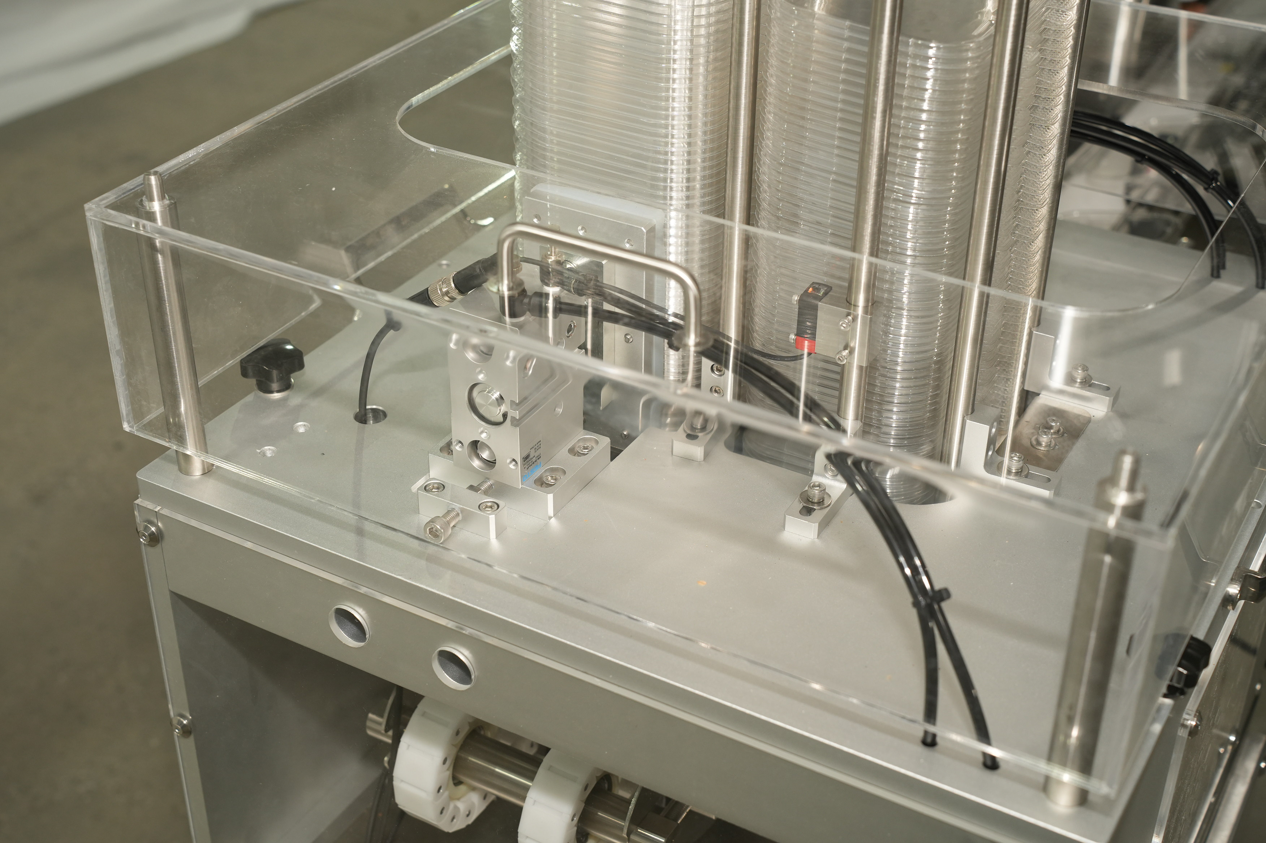
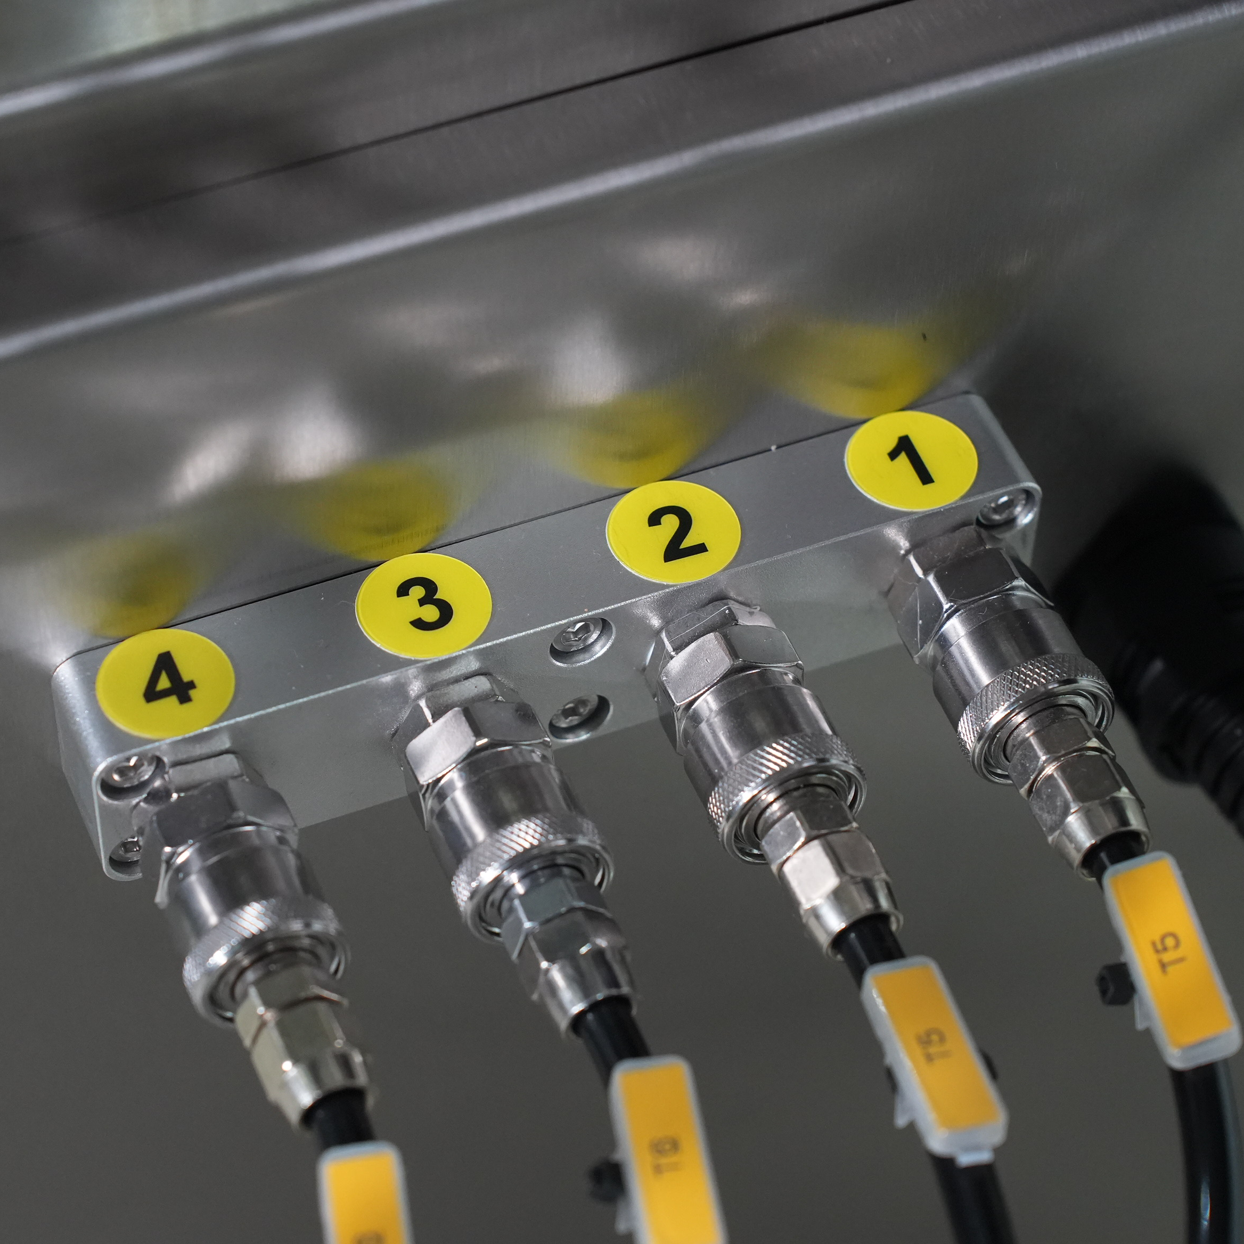
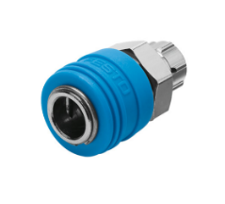

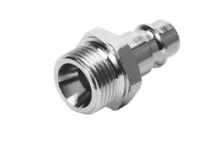
Clamshell Denester
✔ Pneumatic control for denester, simple and maintenance-friendly
✔ Quick-Change denester mechanism: locating pins + quick-release handle + pneumatic coupling enables tool-tooless changeover
✔ Protected by safety cover - ensures operator safety and clean appearance
Pneumatic control, Easy maintenance
Pneumatic Coupling

Slide 8
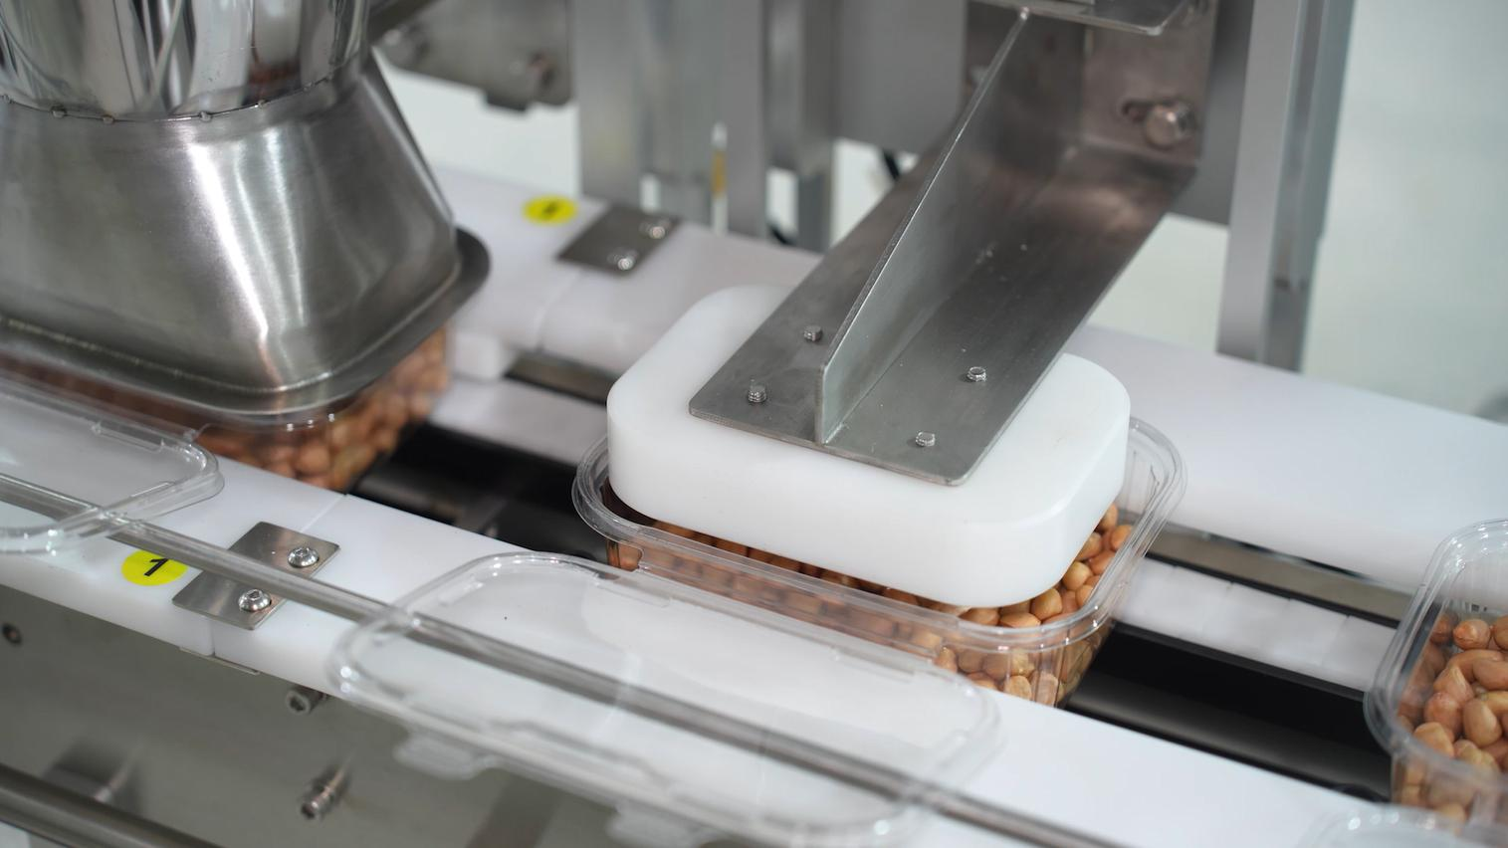
Clean Filling
✔ Pneumatic filling with smart design hopper presses down to prevents spills
✔ Smart compression device to compact product flat inside clamshell for smooth movement
✔ Flexible for different clamshell size with tooless changeover

Slide 9
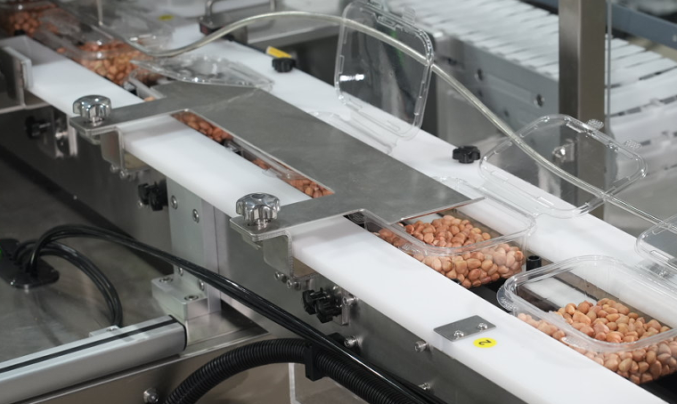
Lid Flip-Top:
✔The lid flips via custom guide rails as the conveyor moves, using physical flipping mechanism for stability
✔Flexible for different clamshell size with tooless changeover

Slide 10
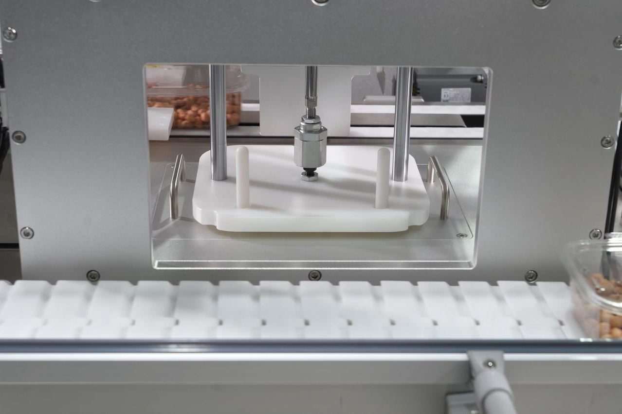
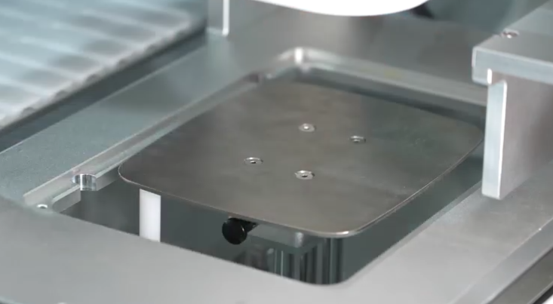
Lid Closing
✔Precision mold alignment + custom closeing tool ensures sealing success
✔Pneumatic pressing - Simple design, easy maintenance
✔Tool-free mold quick-release - Fast changeover for flexiblity

Slide 11
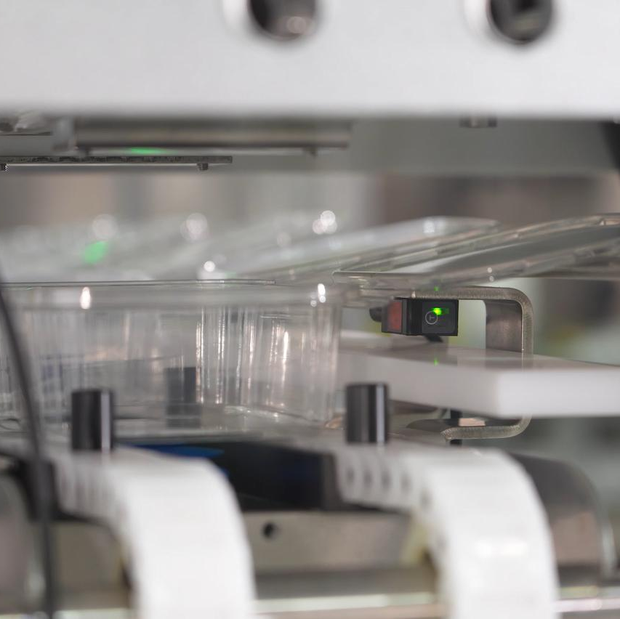
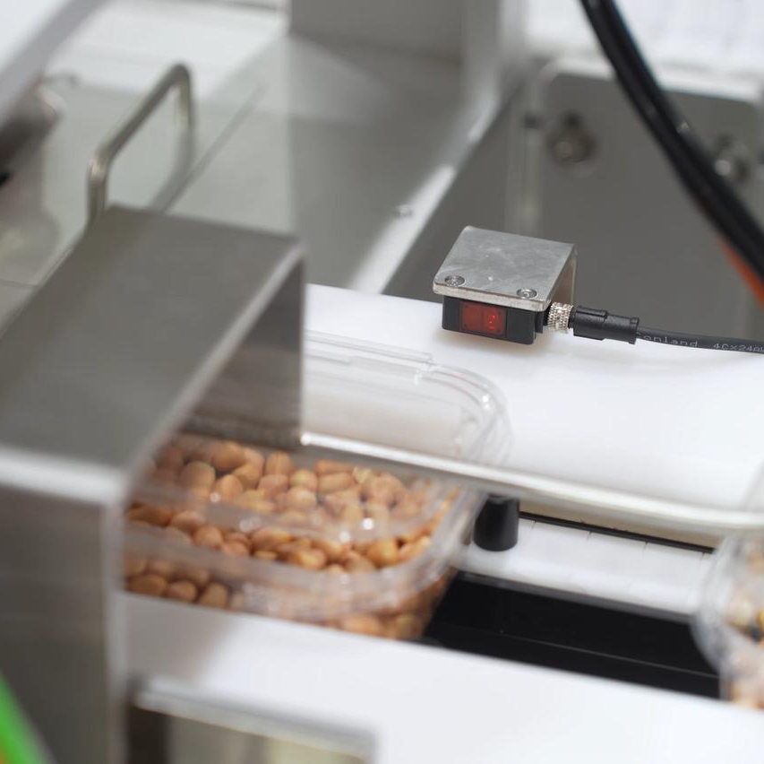
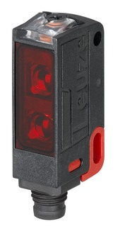
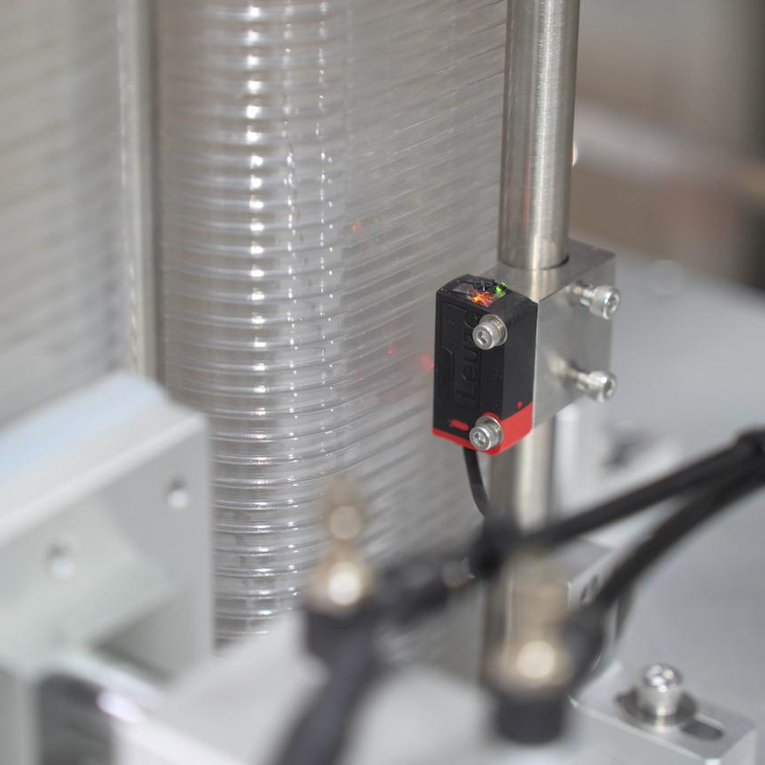
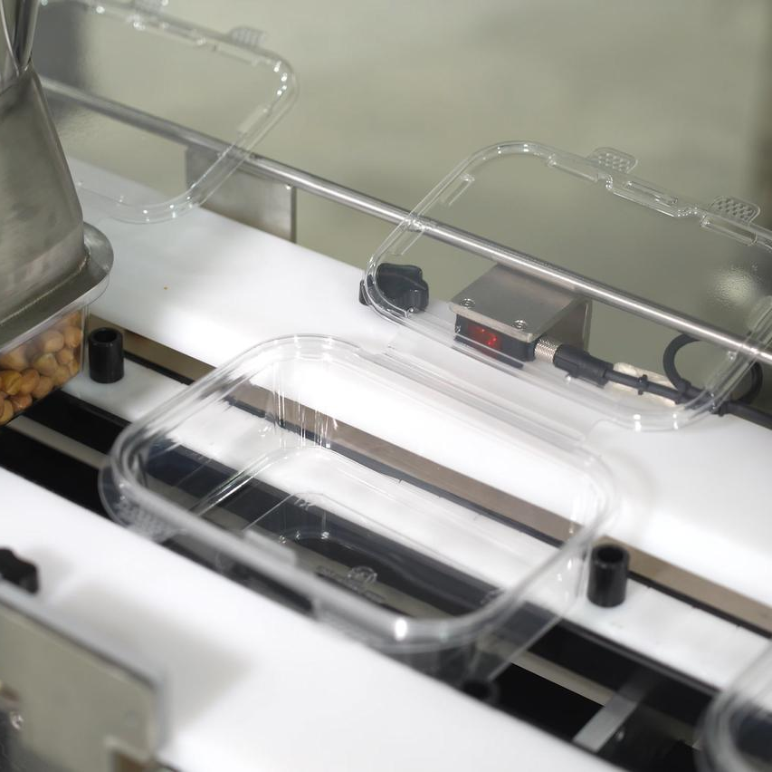
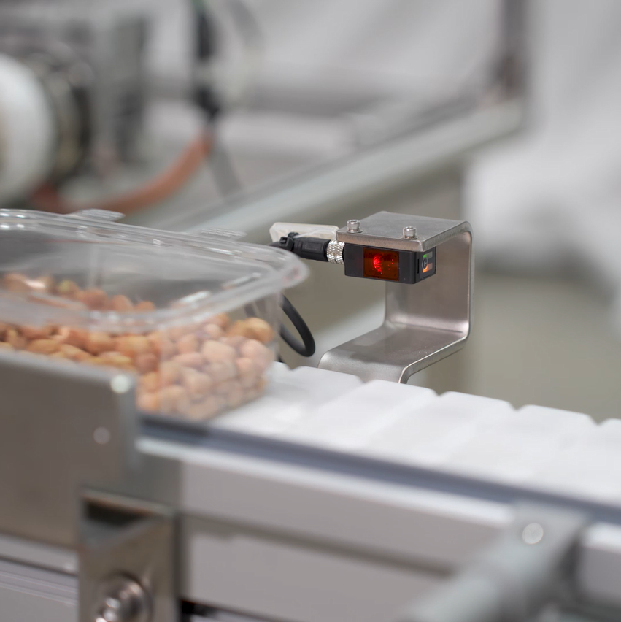
Monitoring:
LEUZE
Sensor
clamshelldetector
flip detector
Level detector
fill detector
Output detector

Slide 12
Thanks for watching
Whatsup：+86-13587497010
Email：info@utmostpack.com
Website：www.utmostpack.com

